Slide 1
Presentation on
Early Detection of Oral Cancer and Other Dental Pathologies Using EfficientNet-B0.
By
Ankita Subhash Patil (16)
Under the Guidance of
Prof. (Dr.) Sagar Shinde
Department of Computer Science and Engineering (Artificial Intelligence)
Thursday, 22 January 2026
1

Slide 2
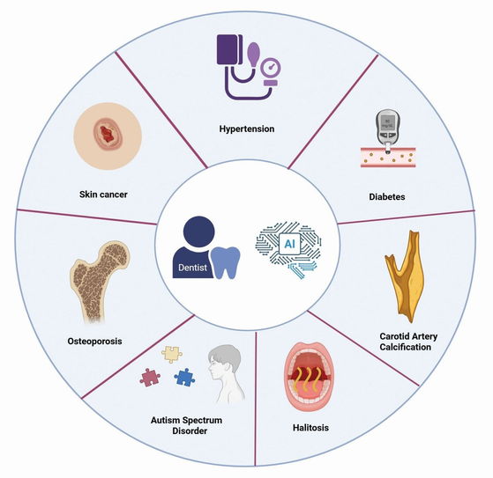
Introduction and Background
Oral Health Screening uses intraoral images and deep learning models to detect oral diseases at an early stage.
The Challenge: Manual diagnosis of oral cancer and dental pathologies depends on expert availability, is time-consuming, and often results in late or inconsistent detection, especially in resource-limited settings.
The Solution: Deep learning models such as EfficientNet-B0 can automatically analyze intraoral images and accurately classify multiple oral conditions, enabling faster and objective diagnosis.
Digital Healthcare & AI are transforming modern medical diagnostics, making early detection, accessibility, and clinical decision support more critical than ever.
2

Slide 3
Problem Statement
Problem Statement - Late detection of oral diseases:
Oral cancer and dental pathologies are often identified at advanced stages due to dependence on manual visual examination and expert availability, leading to delayed treatment and poor patient outcomes.
Problem 01 - Limited and imbalanced medical image data:
Oral disease datasets are often small and imbalanced, with fewer samples for cancer cases, causing AI models to struggle in learning rare but critical patterns.
Problem 02 - Limitations of traditional diagnostic approaches:
Conventional screening methods are subjective, time-consuming, and lack consistency, making large-scale and early oral health screening difficult.
3

Slide 4
Major Project Topic Presentation
Problem Solution
Deep Learning–Based Approach: Implementation of EfficientNet-B0 architecture, which leverages optimized convolutional layers and transfer learning to accurately extract discriminative features from intraoral images.
Transfer Learning Strategy: Utilizing ImageNet pre-trained weights to overcome limited and imbalanced medical image datasets and improve model generalization.
Multi-Class Disease Classification: Designing a unified model capable of detecting oral cancer and multiple dental pathologies (caries, gingivitis, hypodontia, discoloration, normal) simultaneously.
Explainable AI (XAI): Integration of Grad-CAM visualization to highlight lesion regions in intraoral images, enabling interpretability and improving clinical trust in AI-assisted diagnosis.
4

Slide 5
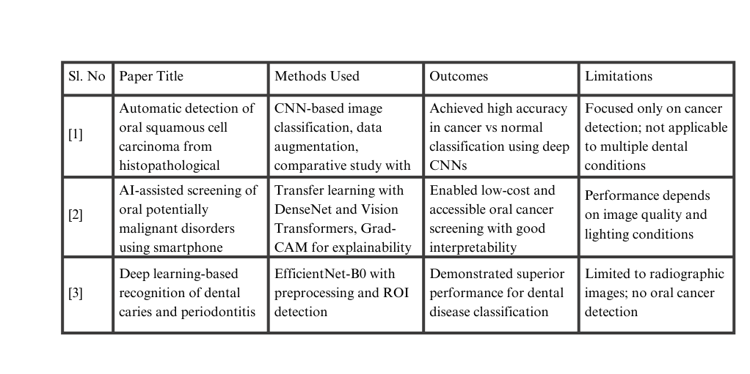
Literature Survey
[3]
5

Slide 6
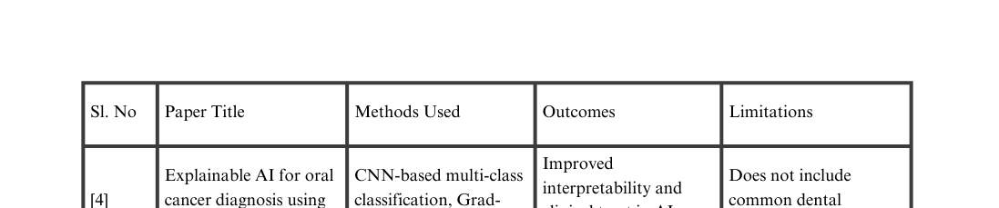
Literature Survey
6

Slide 7
Gap Identified
Gap 1: Limited Multi-Class Coverage
Existing studies mainly focus on single-disease detection, especially oral cancer, ignoring other common dental pathologies.
Our Solution: Developed a multi-class classification framework to detect oral cancer, caries, gingivitis, hypodontia, tooth discoloration, and normal cases simultaneously.
Gap 2: Dataset Size and Imbalance
Prior works rely on small or imbalanced datasets, affecting model reliability and generalization.
Our Solution: Combined multiple publicly available datasets and applied data augmentation to improve class balance and robustness.
Gap 3: Lack of Explainability in AI Models
Many deep learning models function as black boxes, limiting clinical trust and adoption.
Our Solution: Integrated Grad-CAM–based explainable AI, highlighting lesion-specific regions to support clinical interpretation.
Gap 4: Sensitivity to Real-World Image Variations
Existing methods struggle with variations in lighting, resolution, and image quality.
Our Solution: Applied systematic preprocessing and augmentation techniques to ensure stable performance under diverse imaging conditions.
7

Slide 8
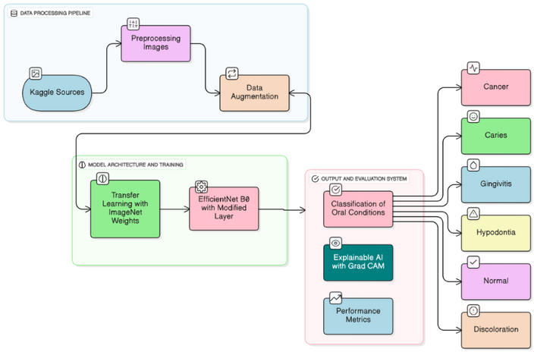
Fig. System Architecture
8

Slide 9
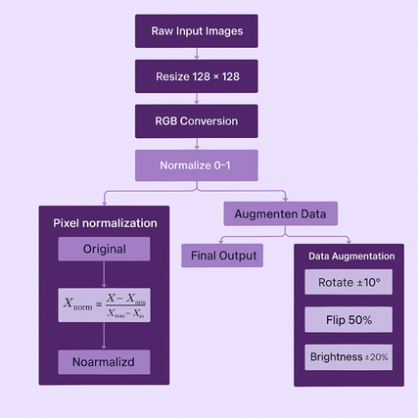
Fig. Image Preprocessing and Normalization Pipeline for Oral Pathology Detection
9

Slide 10
Objectives
To develop an AI-based system for early detection of oral cancer and dental pathologies
To classify multiple oral conditions using intraoral images
To apply EfficientNet-B0 for accurate and efficient feature extraction
To improve model robustness using image preprocessing and data augmentation
To address data imbalance through optimized training strategies
To integrate explainable AI (Grad-CAM) for better clinical interpretability
To evaluate the model using accuracy, precision, recall, and F1-score
10

Slide 11
Experimental Results
Experimental ResultsObservation: The EfficientNet-B0 model demonstrated stable training behavior with consistent improvement in validation accuracy across epochs.
Performance Outcome: The proposed model achieved 95% classification accuracy, with macro precision of 0.93, macro recall of 0.92, and macro F1-score of 0.92 across six oral disease classes.
Class-wise Behavior: High accuracy was observed in detecting oral cancer and common dental pathologies, with minor misclassifications between visually similar conditions.
Explainability Outcome: Grad-CAM visualizations successfully highlighted lesion-specific regions, confirming that the model focused on clinically relevant features.
Final Result: The system proved to be robust, accurate, and interpretable, supporting early detection and reliable clinical decision assistance.
11

Slide 12
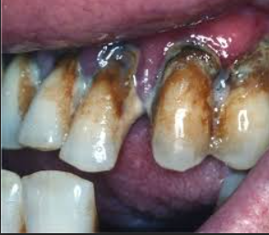
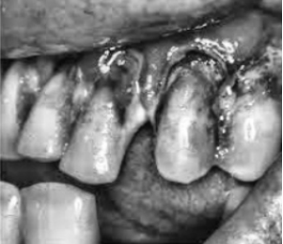
Figure 1(a): Image before preprocessing
This figure shows the original intraoral image captured under varying lighting and noise conditions, which may affect accurate feature extraction.
Figure 1(b): Image after preprocessing
This figure illustrates the preprocessed image after resizing, noise reduction, and normalization, resulting in improved visual clarity for model input.
12

Slide 13
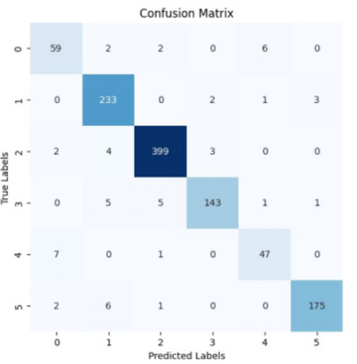
Figure 2: Confusion Matrix
The confusion matrix visualizes class-wise prediction performance, highlighting correct classifications and minor misclassifications among similar oral conditions.
13

Slide 14
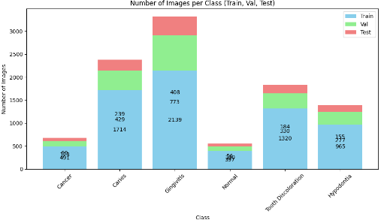
Figure 3: Training and Validation Accuracy/Loss Curves
These curves demonstrate stable learning behavior of the model, showing convergence with minimal overfitting during training.
14

Slide 15
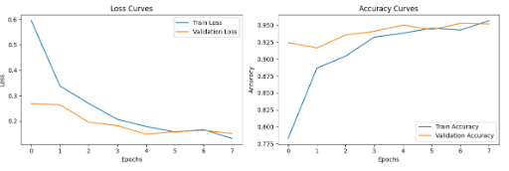
Figure 4: Training and Validation Accuracy/Loss Curves
This figure shows consistent improvement in accuracy and reduction in loss for both training and validation sets, indicating stable learning and minimal overfitting of the model.
15

Slide 16
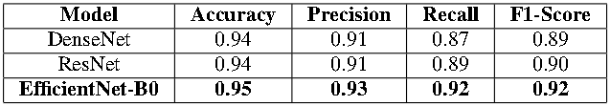
Table 1: Performance comparison table of different models
This table compares the performance of DenseNet, ResNet, and EfficientNet-B0 using standard evaluation metrics. EfficientNet-B0 achieves the highest accuracy, precision, recall, and F1-score, indicating better overall classification performance and balanced detection of oral cancer and dental pathologies compared to the other models.
16

Slide 17
Conclusion
This work presents an AI-based approach for the early detection of oral cancer and other dental diseases using intraoral images. The EfficientNet-B0 model performed better than DenseNet and ResNet, achieving high accuracy along with balanced precision, recall, and F1-score. The use of Grad-CAM helped in clearly showing which areas of the image influenced the model’s decision, improving transparency and clinical trust.
The proposed system can assist dentists in faster and more consistent diagnosis and reduce dependency on manual screening. Overall, this approach shows strong potential for reliable, early, and accessible oral health screening in both clinical and community settings.
17

Slide 18
THANK YOU...!
LOOKING FORWARD FOR QUESTIONS AND
DISCUSSIONS
OPEN TO ADVICES AND INPUTS
18

